Slide 1
AI and Robotics

Slide 2
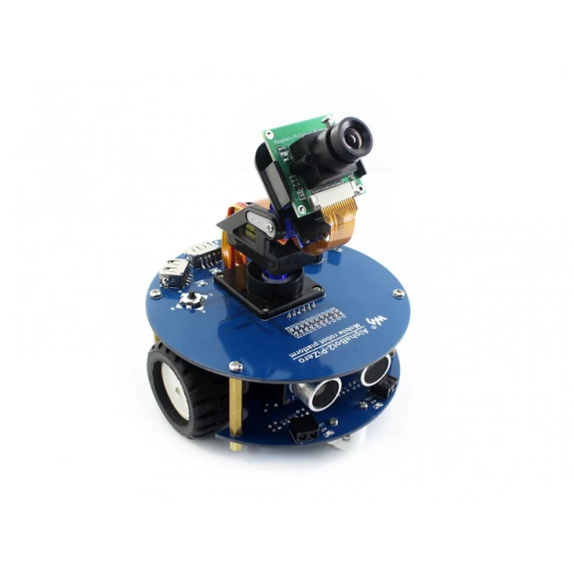
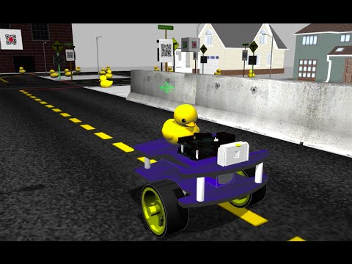
Today Objectives
Session 1: Hand craft rules – alpahbot2 - line following robots
Session 2: Deep learning – duckiebot - virtual environment

Slide 3
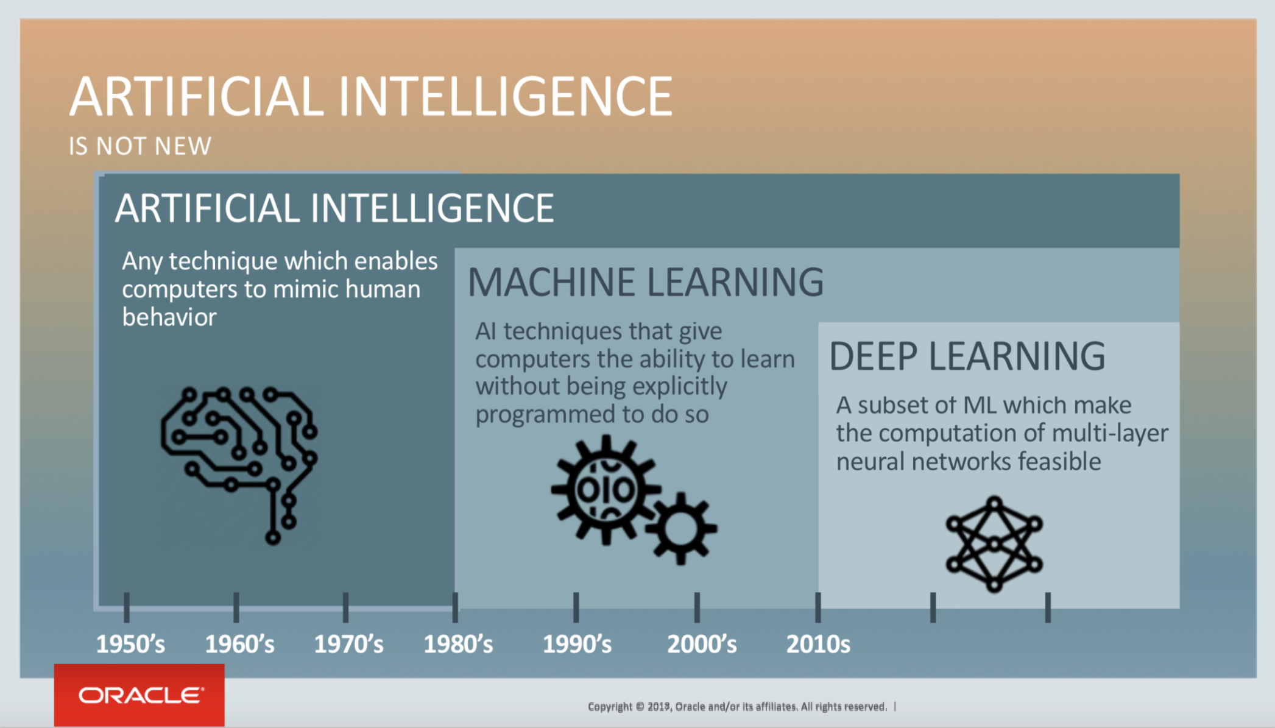
AI
Target
Method
one type of machine learning
Notes:
machine learning – let machine learn themselves
How we do AI before machine learning?
Biology – behavior of a creature depends on two things: 1. innate instinct 2. result of learning

Slide 4
What is Machine Learning 1980’
You write the program for learning
Learn how to differentiate cat and dog
Learn to recognize voice
Looking for a Function From Data
f(x) = y

Slide 5
What is Deep Learning 2010’
Very complicated function
image recognition
Playing GO
Generate Image, voice

Slide 6
Tom Cruise’s Terminator
https://www.youtube.com/watch?v=7fOtCldHl4U

Slide 7
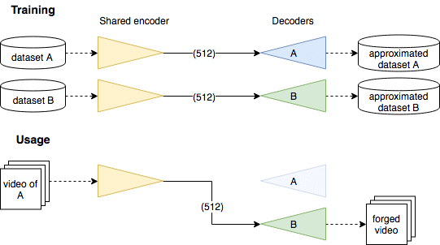
Deep Fake

Slide 8
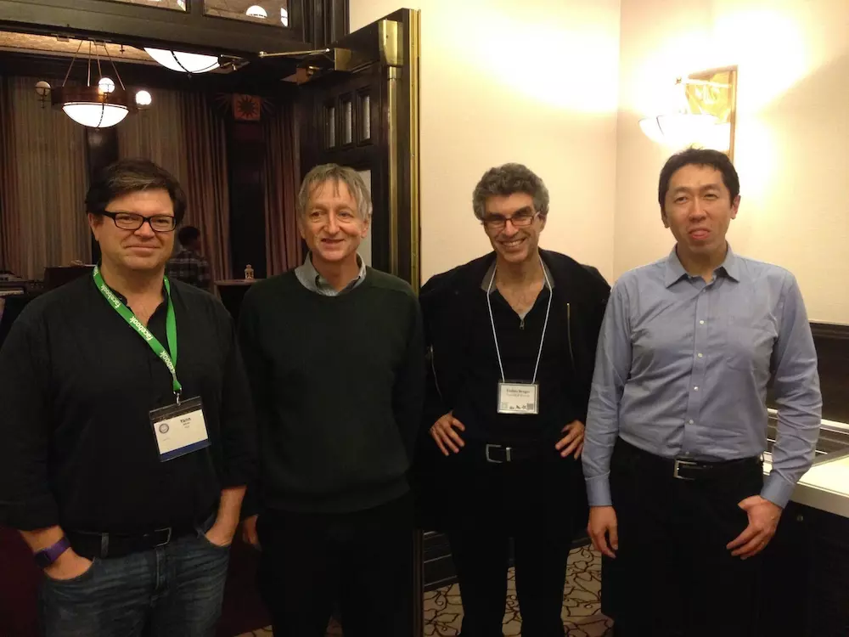
Heroes of Deep Learning
Yann LeCun, Geoffrey Hinton, Yoshua Bengio, Andrew Ng
Notes:
Director of AI Research at Facebook
pioneer of modern deep learning

